Slide 1


Week 6- Self report and professional judgement
Dr Lucy Walker
Lucy.walker@mmu.ac.uk

Slide 2
In this video
Self-report data- uses and problems.
The issues with malingering in forensic psychology.
Inter-rater reliability in structured professional judgment.

Slide 3
Issues with self-report

Slide 4
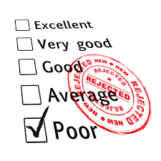
Self-report data
Relies on the test takers own response
Gathered via pen/pencil or electronic formats
Not observation
Notes:
Before we go into the issues we may encounter by using self-report data, lets first remind ourselves what self-report data is.
Self-report data is obtained from any test, measure or survey that relies on the test-takers own report of their- behaviours, beliefs or attitude.
As we have seen throughout this unit, psychological measurements almost always use self-report data- in the form of Likert scales or tick box items.
This can be completed on paper or computerised – depending on the measurement standardization
Because of the nature of self-report data the accuracy of the responses cannot be guaranteed. Instead this depends on personal insight, which may be linked to test taker characteristics such as age, intelligence etc.
With this use of self-report data comes inherit issues we should be aware of.

Slide 5

Social desirability
Tendency to report an answer in a way deemed more socially acceptable than the test taker feels their ‘true response’ would be.
Can be reduced through standardized test administration
Notes:
One issue with self-report data is the chance of social desirability bias- this describes instances where test takers may change their answers to portray themselves in a positive light, indicating higher social desirability.
For example when conducting psychological measurements when applying for jobs- it is understandable that we all may want to come across in the best possible way, meaning this bias is present in our answers.
The influence of social desirability can be reduced through standardized administration procedures as I outlined in week 5’s video.
The issue of social desirability may however be overreported. Many test-takers are in situations where they know accurate responses will contribute best to their welfare. This is where correct administration comes into play- as if while describing the test the importance of answering the questions in the most truthful representative way is emphasised reducing the influence of social desirability.
Scales have also been introduced that measure individual level of social desirability bias- (the Marlowe crowne social desirability scale- 33 item measure). High responses on this scale may indicate thata respondent is generally concerned with social approval .

Slide 6
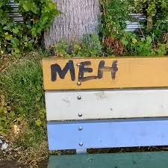
Random responding
“I am answering a survey right now”
Test takers may select responses as random
This may be due to low motivation or coercion to complete the measure
Infrequency scales could be introduced to identify random responses
Agree or Strongly Agree
= Clear correct answer
Notes:
Another problem that may occur in self-report measures is random responding.
Random responding is the problem when test takers pick random answers to questions. This can occur when tests takers are not motivated to complete a measure, this may be in cases where the test outcome has no influence on the individual or in cases of coercion to take a particular test.
In your own dissertation projects- your samples should choose to take part on their own hopefully because they are interested in contributing to your research. If you were to coheres individual's to take part in your surveys, in addition to its being unethical to do so you may encounter issues with your results due to random responding of those individuals.
Methods have been developed to screen for random responding- one of them being infrequency scales
These include questions which have highly skewed response distributions- with distinct correct and incorrect responses
For example if we include the statement ‘I am answering a survey right now’- if participants select agree or strongly agree we can clearly identify these as correct answers. If they select disagree we may assume this individual is responding to the measure carelessly and their responses may bias the results.
However an issue with adding infrequency scale type questions is that it may distract other more motivated test-takers from responding

Slide 7
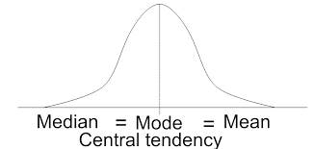
Central tendency
Name given when test takers always choose the central option
May reflect uncertainty in responses
Careful wording of items may help to reduce this
Notes:
Central tendency is the tendency of the test tacker to respond to items using the middle rating scale option.
For example on a 7 point scale from extremely agree- extremely disagree. An individual may consistently use the middle neither agree nor disagree option.
In order to avoid these type of responses questions should be worded clearly- indicating exactly what the question is asking. If the test taker is unclear about a question they are more likely to respond centrally.
Another technique is to leave out the centre items of questions- However unless a measure was standardized with this aspect it could disrupt the validity of this scale if implemented at a later point.

Slide 8
Malingering

Slide 9
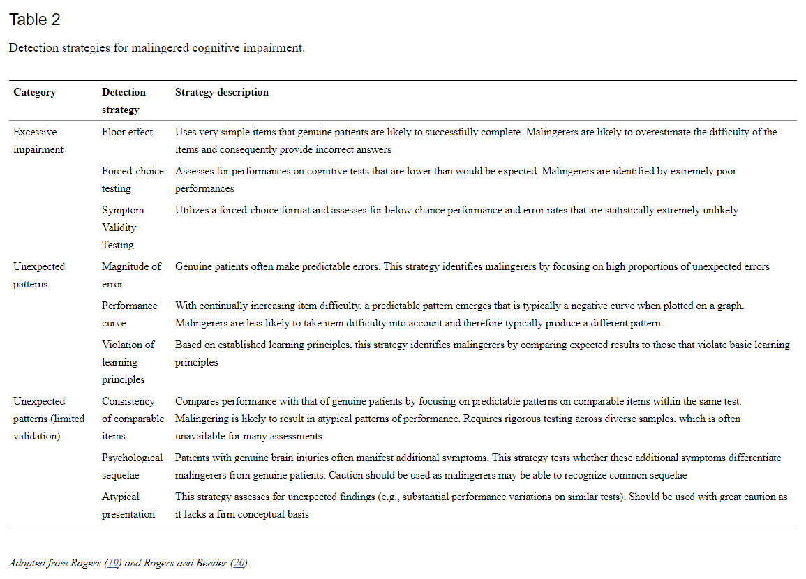
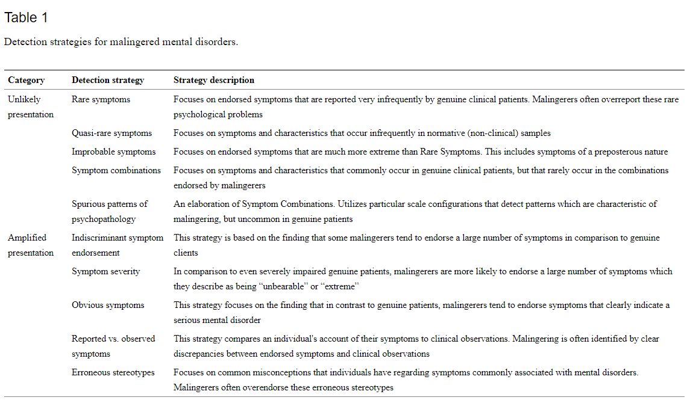
Malingering and Forensic psychology
Walczyk, J. J., Sewell, N., & DiBenedetto, M. B. (2018). A Review of Approaches to Detecting Malingering in Forensic Contexts and Promising Cognitive Load-Inducing Lie Detection Techniques. Frontiers in psychiatry, 9, 700. https://doi.org/10.3389/fpsyt.2018.00700
Notes:
Malingering is defined as the feigning of psychological or physiological ailment for gain (by the DSM- 5).
This poses high costs on society and more specifically in a forensic context to the criminal-justice system.
In the context of the court system- if malingering is present of psychological measurements that are introduced to help assess factors such as cognitive impairment or psychiatric disorders, this can majorly delay the prosecution process. It may also cause issues for security as individual may be moved from more secure settings to environments such as psychiatric facilities which may be less secure.
Rogers et al. validated 10 strategies for the detection of feigning within the domain of mental disorders. These included 2 categories 1.unlikely presentations and 2. amplified presentations.
As you can see from the table I have lifted straight from this review paper some of these unlikely presentations include rare symptoms and unlikely patterns of psychopathy that could be detected using psychological measurements.
Whereas – for amplified presentations this includes – having reported symptoms on psychological measurements that do not match up with those observed.
Factors were also identified for cognitive impairment- including categories of excessive impairment and unexpected patterns.
As you can see from this review it is clear to see the impact of malingering on forensic settings, with psychological measurements playing a key role in both their presentation and detection.

Slide 10
Structured professional judgement

Slide 11
Risk assessments within the criminal justice system
Actuarial
Structured professional judgment (SPJ)
Notes:
What is a risk assessment- the process of gathering information via personal interviews, psychological testing, review of case records, and contact with collateral informants. This is used in making decisions pertaining to an individual's risk.
Psychological measurements play a big role in this but the way they are used varies.
Actuarial assessments- are assessments which strive to achieve empirically accurate classifications with only validated instruments and algorithms (see Otto, 2000)- no professional judgement
Whereas
Structured professional judgement-is the inclusion of Professional judgment of all the evidence including information gained from psychological testing.

Slide 12

Inter-rater reliability- In structured professional judgment.
Reminder- What is inter-rater reliability?
The degree of agreement between raters
Why is this important in SPJ?
Notes:
When structured professional judgment is called for to inform risk assessment, it is important to understand the influence of inter-rater reliability. Within the same and different professional groups making these judgments.
As we have covered inter-rater reliability in the degree of agreement between individual raters of the same information/criteria. By assessing this we can see how much consensus there is between different raters.
Inter-rater reliability is important aspect- as when rating are equal across multiple raters this signifies fair and ethical judgments.

Slide 13
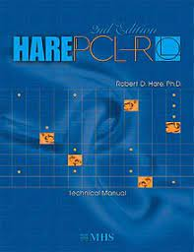
Inter-rater Reliability and the PCL-R
High inter-rater reliability in a research settings
Concerns over the ratings within the real-world setting – where results can be informed by a number of biases.
Edens, J. F., & Vincent, G. M. (2008). Juvenile psychopathy: A clinical construct in need of restraint? Journal of Forensic Psychology Practice, 8, 186–197
Notes:
When taking an example the – Psychopathy checklist revised. This is a psychological measurement that needs an element of judgment and decision making.
Specifically the first Factor, Factor 1- relates to items such as callousness and superficial charm. These rating may be more reliant on subjective ratings
The literature describes how these judgments may have effected ratings within the criminal justice system.
In two US cases of the same male prisoner ratings differed by 15 points – 25 versus 10- the 62nd percentile versus the ninth percentile. These differences in rating could have very serious consciences when it comes to risk and management of the individual within the criminal justice system.
Edens, J. F., & Vincent, G. M. (2008). Juvenile psychopathy: A clinical construct in need of restraint? Journal of Forensic Psychology Practice, 8, 186–197

Slide 14
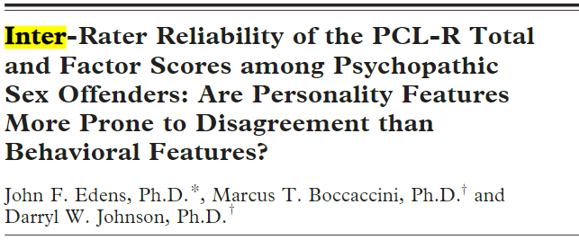
Archival data from a sample of imprisoned sex offenders (N=20), who obtained high PCL-R scores- administered on a second occasion with another examiner.
Intraclass correlations were lower than generally reported in research.
Factor 1- not highly rated.
Notes:
A paper that looked at the PCL-R in particular – based their study off the notion that these differences were occurring within real world setting and not as much in research.
They used archival data from a sample of sex offenders who had all been given high PCL_R scores, they then got a second person to examine the offenders on the same test.
As indicated rating were not as concurrent as seen in research settings and that Factor 1 as described previously being related to more subjective ratings varied more than the overrall rating and Factor 2.

Slide 15
Key references and links
Walczyk, J. J., Sewell, N., & DiBenedetto, M. B. (2018). A Review of Approaches to Detecting Malingering in Forensic Contexts and Promising Cognitive Load-Inducing Lie Detection Techniques. Frontiers in psychiatry, 9, 700. https://doi.org/10.3389/fpsyt.2018.00700
Coaley, K. (2010). The assessment and measurement of personality. In An introduction to psychological assessment and psychometrics (pp. 177-204). SAGE Publications Ltd, https://www-doi-org.mmu.idm.oclc.org/10.4135/9781446221556.n8
Edens, J.F., Boccaccini, M.T. and Johnson, D.W. (2010), Inter‐rater reliability of the PCL‐R total and factor scores among psychopathic sex offenders: are personality features more prone to disagreement than behavioral features?. Behav. Sci. Law, 28: 106-119. https://doi.org/10.1002/bsl.918
Edens, J. F., & Vincent, G. M. (2008). Juvenile psychopathy: A clinical construct in need of restraint? Journal of Forensic Psychology Practice, 8, 186–197

